Slide 1

E-Health application in Macedonia
[ICT and Social media web and mobile solution for the community] case study: socialization of young mothers in Macedonia
Marika A. Trpkovska
Betim Cico, Ivan Chorbev

Slide 2

Presentation Outline
The problem nature
Existing and proposed solutions
Social media practices
  SM in E-Health
www.eMama.mk – Social network
  Vaccination calendar
  Prediction model
  Ontology
Conclusion and future works…
14TH Workshop “Software Engineering Education and Reverse Engineering”
Sinaia, Romania, August 2014

Slide 3

The problem
Young mothers that need instant help
Rural areas
Heath information
in MKD and ALB
Medical support
14TH Workshop “Software Engineering Education and Reverse Engineering”
Sinaia, Romania, August 2014
Notes:
Јас сум родител, мајка на две деца. Најголемата несреќа за еден родител е болно дете, а уште поголем проблем е сомнежот за секоја видлива промена на однесувањето или состојбата на своето дете.
Беше сабота, навечер. Мојот постар син се разбуди со плачење. Се жалеше на болка во дената нога. За кратко се мири и заспа, но во мене се разбуди сомнежот за тоа што може да биде?

Slide 4
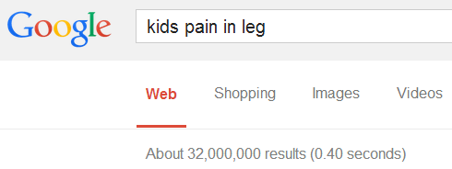
How we do it now
Strained Muscles
Viral Infections
Muscle Cramps
neuritis
(nerve infection)
Growing Pains
Arthritis
14TH Workshop “Software Engineering Education and Reverse Engineering”
Sinaia, Romania, August 2014
Notes:
Бидејќи беше доцна за да вознемирувам некого, како човек од ИТ областа одбрав да пребарам на интернет. Во пребарувачот го впишав симптомот и добив околу 32 милиони резултати. Тоа сепак беше помалиот проблем. Поголем проблем беа резултатите. Првите три не беа нешто страшно но вирусната инфекција, нервната инфекција, артритисот! беа тие што ме вознемирија. Приказната завршува со посета на доктор и дијагноза growing pains.

Slide 5
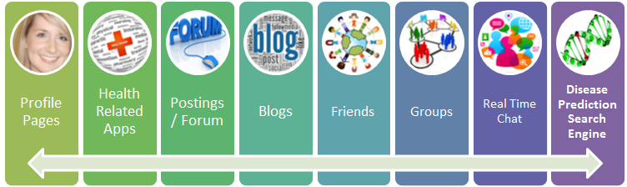

Founding solutions
Physician (45%)
Family person (20%)
Friends (9%)
Internet (26%)
Notes:
Во разговор со повеќе пријатели дојдов до сознание дека ова се изворите од кои се бара совети за “здравствен проблем“: Медицинско лице Поблиско семејство Пријатели Интернет пребарување. Она што интернетот може да го понуди е (сликата). Мојата идеја делумно ги опфаќа форум и блог, а целосно останатите извори.

Slide 6

Existing practices
Social Media for economical, educational, social, political and other purposes.
Social Media used for Health:
  search for health care related topics
  health-related discussions
  commenting about health experiences
  seeking advice from online communities
  professional networking
  affecting the choice of a specific doctor, hospital
  physician-only online community
14TH Workshop “Software Engineering Education and Reverse Engineering”
Sinaia, Romania, August 2014

Slide 7
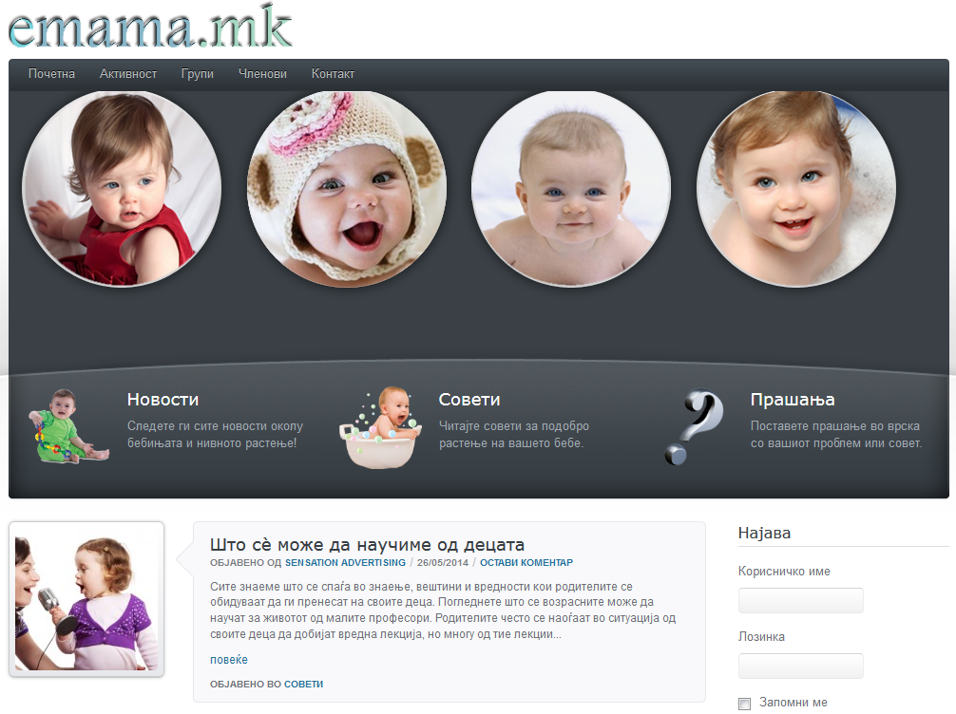
www.eMama.mk
Various Social Features + Immunization Calendar Tool
+ Disease Prediction Tool
14TH Workshop “Software Engineering Education and Reverse Engineering”
Sinaia, Romania, August 2014
Notes:
Mother-to-mother
Interfering other people

Slide 8
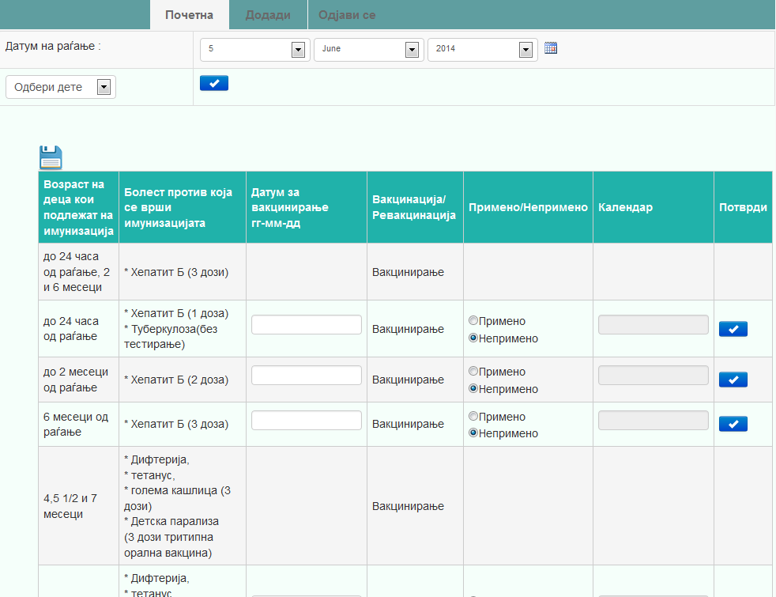
IMMUNIZATION calendar
User Log-in/Log-out page
Adding children
Displaying calendar
Modifying vaccine dates

Slide 9

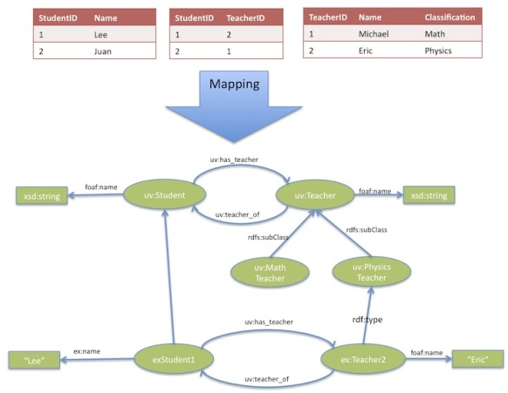
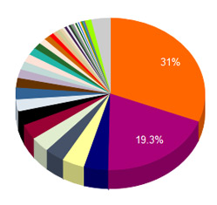
Proposed Prediction model
Questionnaire
Mapping process
Results in %
14TH Workshop “Software Engineering Education and Reverse Engineering”
Sinaia, Romania, August 2014

Slide 10
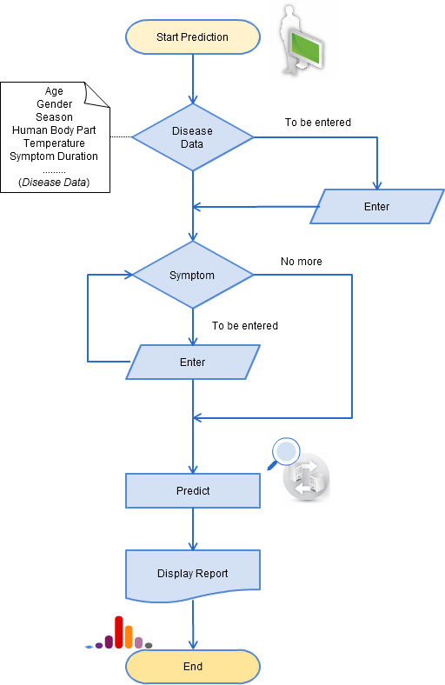
Flow chart of the activities
Start
Entering general disease and patient data
Entering symptoms and place of appearance on child body
Prediction process
Displaying final results in %

Slide 11
ONTOLOGY
For each disease, several clinical practice guidelines and scientiﬁc papers were considered to identify the corresponding signs and symptoms, interventions, and other disease related data.
Protégé was the tool used to construct the ontology.
All the information extracted from these documents together with the professional experience of the physicians was manually incorporated to the ontology as classes, properties, property constraints, relations, SWRL rules…
14TH Workshop “Software Engineering Education and Reverse Engineering”
Sinaia, Romania, August 2014

Slide 12
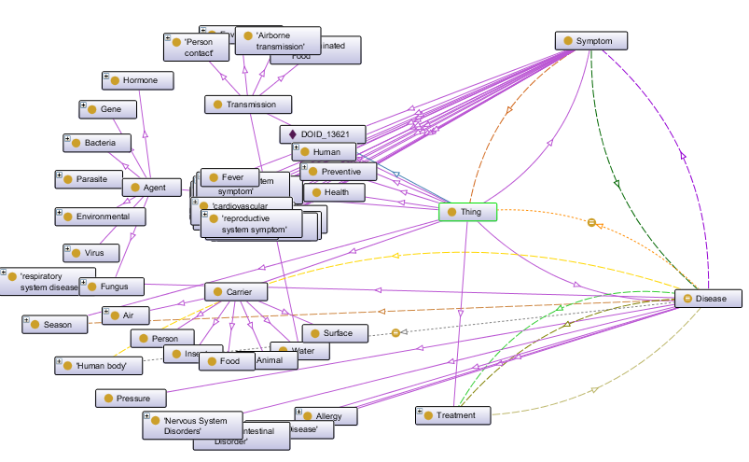
14TH Workshop “Software Engineering Education and Reverse Engineering”
Sinaia, Romania, August 2014

Slide 13
Analyzing data
The overall system and prediction model would be mathematically supported.
PROPOSALS:
Using Gaussian method to point out the efficiency of the prediction process concerning to real doctor practice.
Using Fuzzy logic to catch different parameter relation and their influence on prediction process.
14TH Workshop “Software Engineering Education and Reverse Engineering”
Sinaia, Romania, August 2014

Slide 14
Conclusion
The social media and other communication modes now can be seen as a powerful tool for health research like everywhere.
Through this work we bring together young mothers, doctors and other to be all in one online place.
We introduce a research on the use of social networks to face the future of health care deliverance by proposing a system that can assist an ordinary young mother in decision making.
Currently we are implementing, testing and evaluating the system to determine it’s endorse.
14TH Workshop “Software Engineering Education and Reverse Engineering”
Sinaia, Romania, August 2014

Slide 15
Future work
The evaluation process.
Working to transform the system completely in Mobile and Cloud.
Upgrading the existing disease ontology.
Implementing some security elements in our social network.
Cooperation with Ministry of Health in Macedonia.
14TH Workshop “Software Engineering Education and Reverse Engineering”
Sinaia, Romania, August 2014

Slide 16
research papers
Apostolova Trpkovska, M., Cico, B., Chorbev, I., 2014. Application of Social Media in Health. MECO 2014. IEEE. Budva.
Apostolova Trpkovska, M., Cico, B., Chorbev, I., 2014. Using Social Media To Predict Children Disease Occurrence, pp. 209 - 216. ISBN 978-989-8704-0. Madrid, IADIS.
Apostolova Trpkovska, M., 2013. An Overview of Health 2.0 and Semantic Web. Dubai, IJCEBS.
Apostolova-Trpkovska, M., Abazi-Bexheti, L., 2013. Concerns and Strategies of Housing the Implementation of E-Medical Services in Macedonia. Cavtat, Information Technology Interfaces (ITI).
Apostolova-Trpkovska, M., Cico, B., 2013. Prototype System for Multiple Sources Multiple Search Techniques Prediction. Tirana, EPOKA University.
Apostolova Trpkovska, M., Chorbev, I., 2012. Study of Social Networks and Their Impact on Patients and Health Care. Tirana, ISTI.
Apostolova-Trpkovska, M., 2012. Study of Social Networks and Its Impact on Patients and Health Care. Tirana, IJSINT. Publication of ASET.

Slide 17

Thank you for your attention.
Any question or sugestion?
14TH Workshop “Software Engineering Education and Reverse Engineering”
Sinaia, Romania, August 2014

